Slide 1






Home
Content
Service
Contact
RULE YOUR USELESS GOODS WITH
FZZ
——Internet Platform Industry
Transforming the Way You Manage MONEY💴 of Second-hand Goods
Demand Analysis
FZZ
TEAM: FUZHUAN
Reuse, Revive, Reconnect
– Your Campus Marketplace

Slide 2
Home
About Us
Service
Contact
CONTENTS
Introduction
Overall Description
Function Refinement
Interface Prototype
Function Description and Acceptance Verification Standards

Slide 3
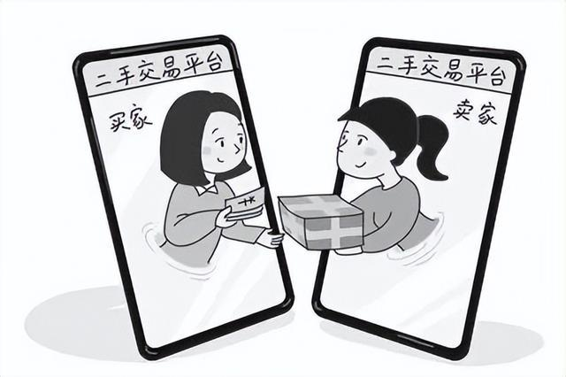
Home
About Us
Service
Contact
Introduction
User-Centered Design
Secure Trading Environment
Recourse Recycling Initiative
Market Analysis Insights
Efficient Implementation Plan
FZZ Applet
A good companion for your life, from now on selling used items becomes simple!

Slide 4
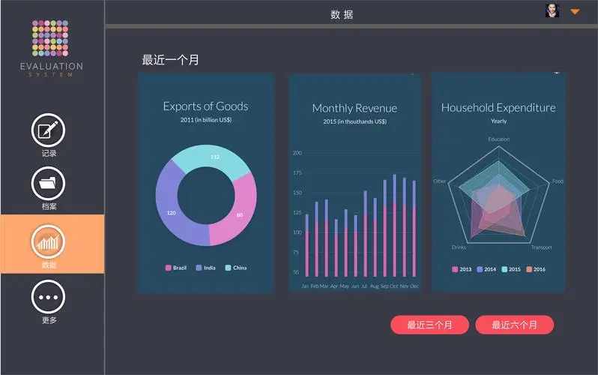
Home
About Us
Service
Contact
Objectives
Overall Description
Development Intention
Application Goals
Scope of Application
Product Prospects

Slide 5
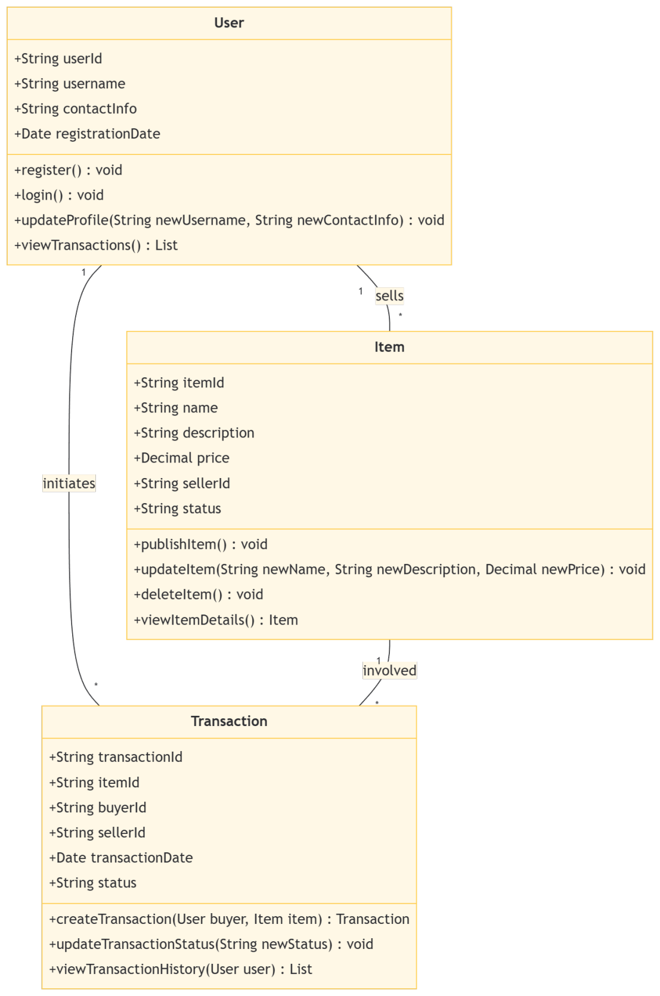
Home
About Us
Service
Contact
Class Diagrams
User Class
Item Class
Transaction
Class

Slide 6


Avaulability
Home
About Us
Service
Contact
Function Refinement
Properties
Availability
Security

Slide 7
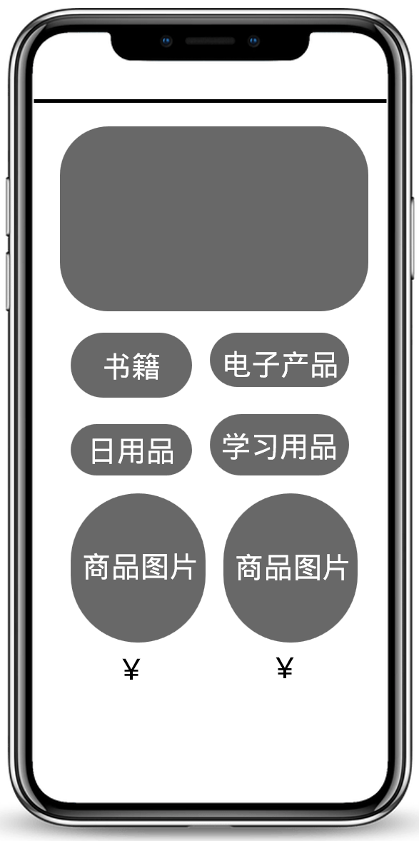

Avaulability
Home
About Us
Service
Contact
Interface Prototype
User Experience
Login
Item Browsing
Item Detail
Transaction Record

Slide 8

Home
About Us
Service
Contact
Function Description
Acceptance Verification Standards
Detailed Function Description
Input and Output Format
Interface Acceptance Criteria
Functional Acceptance Criteria
Making sure the user experience is good is a top priority.

Slide 9
Home
About Us
Service
Contact
Thank
You
Reuse, Revive, Reconnect
– Your Campus Marketplace

